Slide 1
Hierarchical Routing
In hierarchical routing, the routers are divided into regions. Each router has complete details about how to route packets to destinations within its own region. But it does not have any idea about the internal structure of other regions.
Every router needs to save some information about other routers. When network size is growing, the number of routers in the network will increase. Therefore, the size of routing table increases, then routers cannot handle network traffic as efficiently. To overcome this problem we are using hierarchical routing.
Not only is router memory consumed by ever-increasing tables, but more CPU time is needed to scan them and more bandwidth is needed to send status reports about them.
At a certain point, the network may grow to the point where it is no longer feasible for every router to have an entry for every other router, so the routing will have to be done hierarchically, as it is in the telephone network.

Slide 2
Hierarchical Routing
For huge networks, a two-level hierarchy may be insufficient; it may be necessary to group the regions into clusters, the clusters into zones, the zones into groups, and so on, until we run out of names for aggregations.
When hierarchical routing is used, the routers are divided into what we will call regions.
Each router knows all the details about how to route packets to destinations within its own region but knows nothing about the internal structure of other regions.
When different networks are interconnected, it is natural to regard each one as a separate region to free the routers in one network from having to know the topological structure of the other ones.

Slide 3
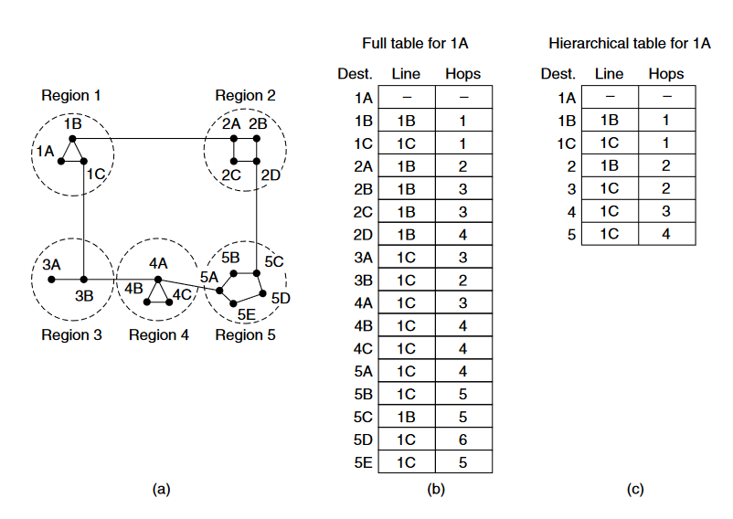
Hierarchical Routing

Slide 4
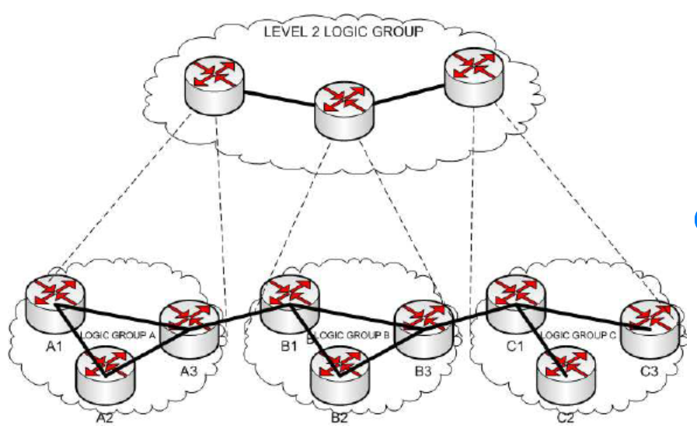
Hierarchical Routing

Slide 5
Hierarchical Routing
The figure gives a quantitative example of routing in a two-level hierarchy with five regions. The full routing table for router 1A has 17 entries, as shown in figure b.
When routing is done hierarchically, as in fig (c), there are entries for all the local routers, as before, but all other regions are condensed into a single router, so all traffic for region 2 goes via the 1B-2A line, but the rest of the remote traffic goes via the 1C-3B line.
Hierarchical routing has reduced the table from 17 to 7 entries. As the ratio of the number of regions to the number of routers per region grows, the savings in table space increase.
Unfortunately, these gains in space are not free. There is a penalty to be paid: increased path length.
For example, the best route from 1A to 5C is via region 2, but with hierarchical routing all traffic to region 5 goes via region 3, because that is better for most destinations in region 5.

Slide 6
Hierarchical Routing
When a single network becomes very large, an interesting question is ‘‘how many levels should the hierarchy have?’’
For example, consider a network with 720 routers. If there is no hierarchy, each router needs 720 routing table entries.
If the network is partitioned into 24 regions of 30 routers each, each router needs 30 local entries plus 23 remote entries for a total of 53 entries.
If a three-level hierarchy is chosen, with 8 clusters each containing 9 regions of 10 routers, each router needs 10 entries for local routers, 8 entries for routing to other regions within its own cluster, and 7 entries for distant clusters, for a total of 25 entries.
Kamoun and Kleinrock (1979) discovered that the optimal number of levels for an N router network is ln N, requiring a total of e ln N entries per router.
They have also shown that the increase in effective mean path length caused by hierarchical routing is sufficiently small that it is usually acceptable.

Slide 7
Hierarchical Routing-Benefits
Scalability: Hierarchical routing protocols exhibit excellent scalability by partitioning the network into smaller segments or areas.
This division reduces the demand for routing tables and updates on each router, enhancing network efficiency and decreasing overall network traffic.
Better Traffic Control: Hierarchical routing protocols demonstrate superior traffic management compared to flat routing protocols.
The hierarchical framework enables more efficient traffic control, mitigating the need for unnecessary routing updates and preventing loops in the network.
Easy to Manage: The organizational framework in these protocols facilitates simplified management and maintenance.
Segmentation of the network into manageable sections enhances the ease of troubleshooting and diagnosing issues.

Slide 8
Hierarchical Routing-Limitations
Complexity: Hierarchical routing protocols tend to be more intricate compared to flat routing protocols.
The presence of additional layers and segments necessitates more extensive configuration, posing potential challenges in implementation.
Latency: Latency may be introduced into the network due to the presence of additional layers and segments. Such delays in data transmission can pose challenges, particularly for real-time applications.
Protocols of Hierarchy.

Slide 9
Broadcast Routing
Sending a packet to all destinations simultaneously is called broadcasting.
Various methods have been proposed for doing it.
One broadcasting method that requires no special features from the network is for the source to simply send a distinct packet to each destination.
Not only is the method wasteful of bandwidth and slow, but it also requires the source to have a complete list of all destinations.
Multidestination routing :
in which each packet contains either a list of destinations or a bit map indicating the desired destinations.
When a packet arrives at a router, the router checks all the destinations to determine the set of output lines that will be needed.
The router generates a new copy of the packet for each output line to be used and includes in each packet only those destinations that are to use the line.

Slide 10
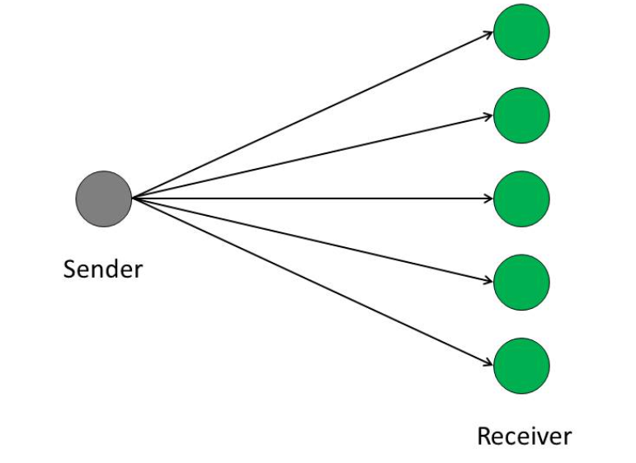
Broadcast Routing

Slide 11
Broadcast Routing
In effect, the destination set is partitioned among the output lines. After a sufficient number of hops, each packet will carry only one destination like a normal packet.
Multidestination routing is like using separately addressed packets, except that when several packets must follow the same route, one of them pays full fare and the rest ride free.
The network bandwidth is therefore used more efficiently. However, this scheme still requires the source to know all the destinations, plus it is as much work for a router to determine where to send one multidestination packet as it is for multiple distinct packets.
When implemented with a sequence number per source, flooding uses links efficiently with a decision rule at routers that is relatively simple.
Although flooding is ill suited for ordinary point-to-point communication, it rates serious consideration for
broadcasting.
However, it turns out that we can do better still once the shortest path routes for regular packets have been computed.

Slide 12
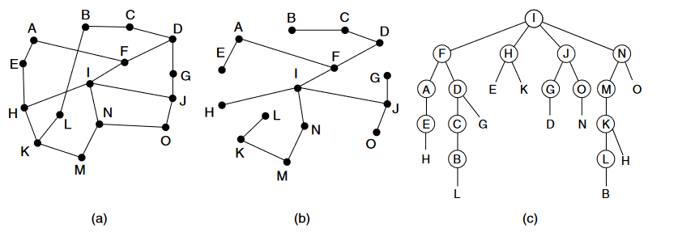
Broadcast Routing
Reverse path forwarding : is elegant and remarkably simple once it has been pointed out (Dalal and Metcalfe, 1978).
When a broadcast packet arrives at a router, the router checks to see if the packet arrived on the link that is normally used for sending packets toward the source of the broadcast.
If so, there is an excellent chance that the broadcast packet itself followed the best route from the router and is therefore the first copy to arrive at the router.
This being the case, the router forwards copies of it onto all links except the one it arrived on. If, however, the broadcast packet arrived on a link other than the preferred one for reaching the source, the packet is discarded as a likely duplicate.

Slide 13
Broadcast Routing
An example of reverse path forwarding is shown in Fig (a) shows a network, Fig (b) shows a sink tree for router I of that network, and Fig C shows how the reverse path algorithm works.
On the first hop, I sends packets to F, H, J, and N, as indicated by the second row of the tree. Each of these packets arrives on the preferred path to I (assuming that the preferred path falls along the sink tree) and is so indicated by a circle around the letter.
On the second hop, eight packets are generated, two by each of the routers that received a packet on the first hop.
As it turns out, all eight of these arrive at previously unvisited routers, and five of these arrive along the preferred line. Of the six packets generated on the third hop, only three arrive on the preferred path (at C, E, and K); the others are duplicates.
After five hops and 24 packets, the broadcasting terminates, compared with four hops and 14 packets had the sink tree been followed exactly.

Slide 14
Broadcast Routing
The principal advantage of reverse path forwarding is that it is efficient while being easy to implement.
It sends the broadcast packet over each link only once in each direction, just as in flooding, yet it requires only that routers know how to reach all destinations, without needing to remember sequence numbers (or use other mechanisms to stop the flood) or list all destinations in the packet.
Our last broadcast algorithm improves on the behavior of reverse path forwarding. It makes explicit use of the sink tree or any other convenient spanning tree for the router initiating the broadcast.
A spanning tree is a subset of the network that includes all the routers but contains no loops. Sink trees are spanning trees.
If each router knows which of its lines belong to the spanning tree, it can copy an incoming broadcast packet onto all the spanning tree lines except the one it arrived on. This method makes excellent use of bandwidth, generating the absolute minimum number of packets necessary to do the job.

Slide 15
Broadcast Routing- Benefits
Efficient Data Distribution: Broadcast routing ensures that information reaches all intended recipients simultaneously. This efficiency makes it ideal for applications such as live event broadcasting, software updates distribution or emergency alerts.
Scalability: It allows networks to expand without requiring routing configurations. Adding devices to a network doesn’t necessitate changes making it practical for large scale networks.
Reliability: Broadcast routing provides communication redundancy. If one path fails data can still be delivered through routes enhancing the reliability of the network.
Security: Although broadcast routing is commonly associated with broadcasts it can also be employed in networks, for secure communications. In cases encryption and access control mechanisms are utilized to ensure data privacy.

Slide 16
Broadcast Routing- Limitations
Broadcast Storms: Flooding based broadcast routing can result in broadcast storms, where an overwhelming amount of traffic floods the network leading to congestion and decreased efficiency. Network administrators implement measures, like storm control and rate limiting to tackle this issue.
Security Concerns: Broadcasting information, over networks can pose security risks. To address this encryption and authentication mechanisms are commonly employed to safeguard data during transmission.
Scalability: Managing broadcast traffic becomes more complex as networks grow larger. To maintain scalability it is beneficial to implement broadcast domains and utilize routing algorithms.
Bandwidth Consumption: It is crucial to design and monitor the network to prevent overload caused by broadcast traffic as it consumes network bandwidth.

Slide 17
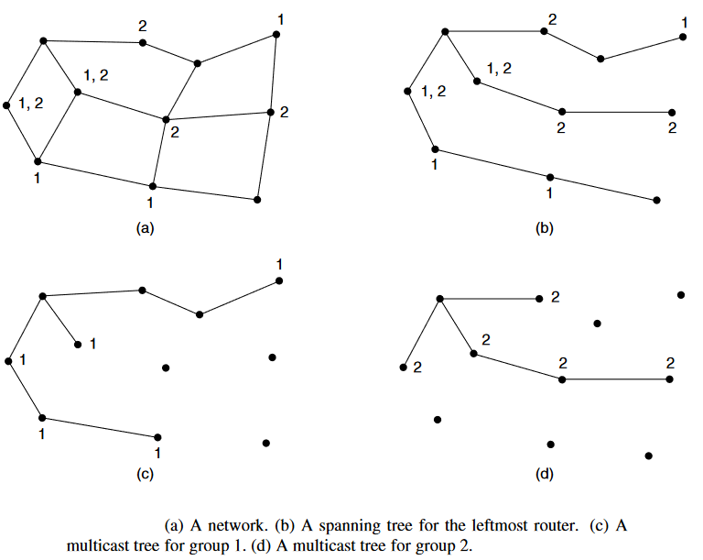
Multicast Routing
Sending a message to a group is called multicasting, and the routing algorithm used is called multicast routing.
All multicasting schemes require some way to create and destroy groups and to identify which routers are members of a group.
How these tasks are accomplished is not of concern to the routing algorithm. For now, we will assume that each group is identified by a multicast address and that routers know the groups to which they belong.

Slide 18
Multicast Routing
As an example, consider the two groups, 1 and 2, in the network shown in Fig (a).
Some routers are attached to hosts that belong to one or both of these groups, as indicated in the figure.
A spanning tree for the leftmost router is shown in Fig.(b). This tree can be used for broadcast but is overkill for multicast, as can be seen from the two pruned versions that are shown next.
In Fig. (c), all the links that do not lead to hosts that are members of group 1have been removed. The result is the multicast spanning tree for the leftmost router to send to group 1.
Packets are forwarded only along this spanning tree, which is more efficient than the broadcast tree because there are 7 links instead of 10.
Fig. (d) shows the multicast spanning tree after pruning for group 2. It is efficient too, with only five links this time. It also shows that different multicast groups have different spanning trees.

Slide 19
Multicast Routing-Benefits
Optimized network performance:
The intelligent use of network resources avoids unnecessary flow replication. This way, an economy in terms of passing band is achieved through a better architecture to distribute the data.
Support to distributed applications:
Multicast technology is directed towards distributed applications. Multimedia applications such as distance learning and videoconference can be used in the network in a measurable and effective way.
Resource economy:
The cost of the network resources is reduced through the passing band economy in the links and the processing economy in servers and network equipment. New applications and services can be implanted, without requiring the renovation of network resources.
Scalability:
The effective use of the network and the reduction of the load in traffic sources permit services and applications to be accessed by a great number of participants. Consequently, services that run on multicast can be easily dimensioned, distributing packages both to few and to a lot of receivers.
More network availability:
The economy of network resources associated to the reduction of the load in the applications and servers makes the network less susceptible to jams, and, therefore, more available to be used.

Slide 20
Multicast Routing-Limitations
Best Effort Delivery: Drops are to be expected. Multicast applications should not expect reliable delivery of data and should be designed accordingly. Reliable Multicast is still an area for much research.
No Congestion Avoidance: Lack of TCP windowing and “slowstart” mechanisms can result in network congestion. If possible, Multicast applications should attempt to detect and avoid congestion conditions.
Duplicates: Some multicast protocol mechanisms result in the occasional generation of duplicate packets. Multicast applications should be designed to expect occasional duplicate packets.

Slide 21
Broadcast Vs Multicast Routing
Factors | Broadcast | Multicast
Basic | One-to-all | One-to-many
Transmission | The sender transmits data to all receivers in the network, regardless of their interest. | The sender transmits data to a group of receivers who have joined the multicast group.
Management | No group management is required. | Group management protocols are needed to join and leave multicast groups.
Bandwidth | Wastes bandwidth as data is sent to uninterested receivers. | Saves bandwidth as data is sent only to interested receivers.
Traffic | Generates more network traffic as data is replicated at every router. | Generates less network traffic as data is replicated only at branching points.
Process | Simple and easy to implement. | Complex and requires more processing power.
Security | Less secure as data is exposed to all receivers. | More secure as data is delivered only to authorized receivers.

